Slide 1
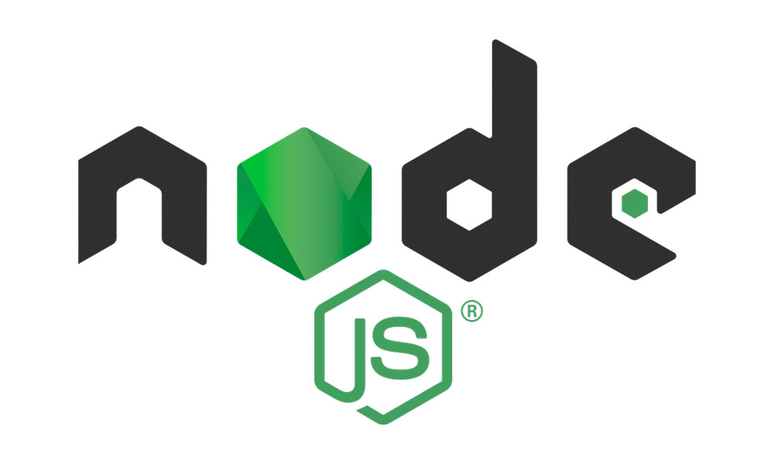
Types of Errors
Syntax Errors
RunTime Errors
Logical Errors
Typo mistake, Missed parentheses, brackets or semicolons , Wrong naming convention. (etc)
Errors that occur during program execution, often due to unexpected conditions or invalid operations.
Here you’ll never see error message, but your app doesn’t work the way it should.

